Slide 1
Free Lunches & NP-Complete Problems
Dr. Daniel Hulme
07773765097 // @TheSolveEngine
daniel@satalia.com // d.hulme@ucl.ac.uk
Masters (Msci) in Computer Science with Machine Learning @ UCL
Doctorate (EngD) in Computational Complexity @ UCL
Research Scientist in Optimisation & Innovation @ UCL
Impact Associate for Dept. of Computer Science @ UCL
Lecturer of New Venture Analytics // Software Engineering @ UCL
Lecturer of Business Decision Making // Managing Comms @ Pearson
Founder & CEO of Satalia (NPComplete Ltd) @ UCL
Recipient of a Kauffman Global Scholarship
Visiting Fellow in BigData @ The Big Innovation Centre
Board Director and Advisor to various UK and US companies
Copyright 2008-2014 NPComplete Ltd

Slide 2
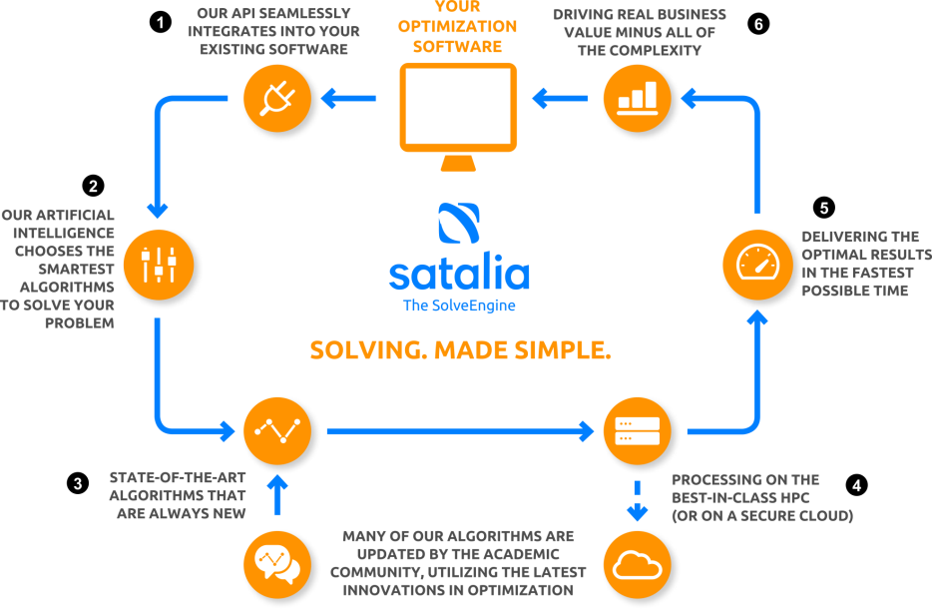
Notes:
The SSE utilises standard tools, including Apache Web-server, MySQL, Open Grid Engine (if required). The optimisation algorithms are either open-source, freely available, developed in-house or licenced directly from the academics (or commercial providers) as necessary. Below is a high-level diagram of the SSE components.

Slide 3
Data-Driven Decision Making
Optimisation Algorithms
Machine Learning
Aggregation & Visibility
Decision Making
Decision Scientists
Analytics & Visualisation
Data Scientists
Access & Storage
Security & Resilience
BIG WISDOM
ACTION
BIG UNDERSTANDING
INSIGHT
BIG KNOWLEDGE
BIG INFORMATION
DATA
BIG DATA

Slide 4
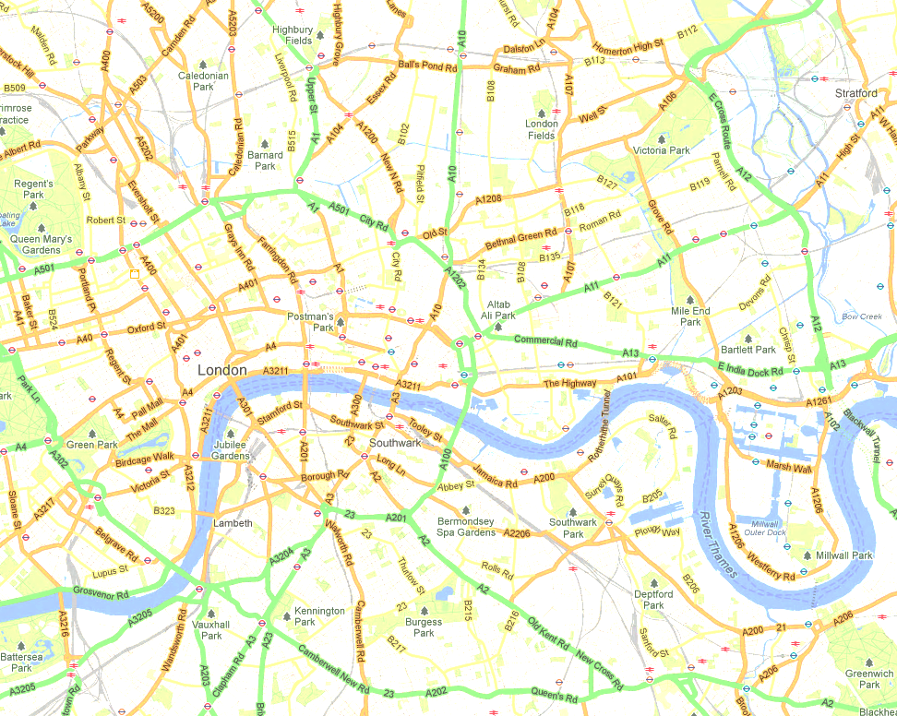
The “Big O”
POINTS | ROUTES | MEGA OPS PER SECOND
10 | 3,628,800 | 4 seconds
11 | 39,916,800 | 1 minute
13 | 6,227,020,800 | 2 hours
14 | 87,178,291,200 | 1 day
16 | 20,922,789,888,000 | 1 year
20 | 2,432,902,008,176,640,000 | 77,000 years
22 | 1,124,000,727,777,610,000,000 | 36 millennia
24 | 620,448,401,733,239,000,000,000 | 20 billion years
Odd or Even: O(1)
Ordered Search: O(log n)
Sorting Items: O(n²)
Travelling Salesman: O(n!)

Slide 5
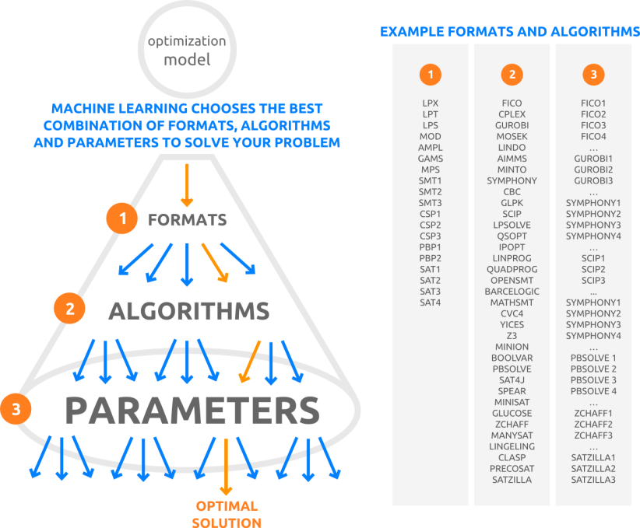

Slide 6
Graph 3-Colourability
X₀
X₄
X₁
X₂
X₃

Slide 7
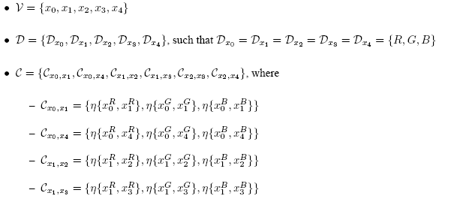
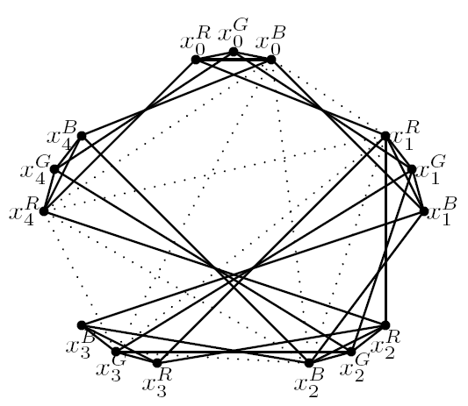

CSP Micro-structure (complement)

Slide 8
Graph 3-Colourablity
X₀
X₄
X₁
X₂
X₃

Slide 9
Boolean Satisfiability
The ‘mother’ of all NP-Complete problems
Modern SAT-Solvers
Millions of variables (2^{1x10^6})
SAT Competition
Synergies between CSP <-> SAT

Slide 10
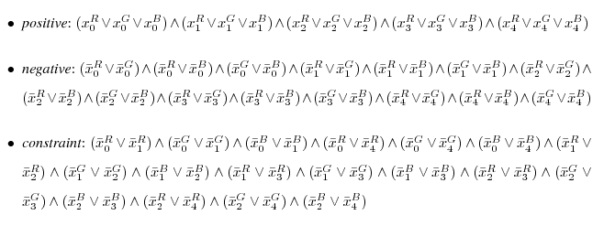
Encoding CSPs into SAT (DIRECT)

Slide 11
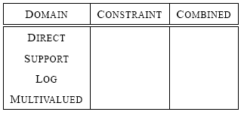
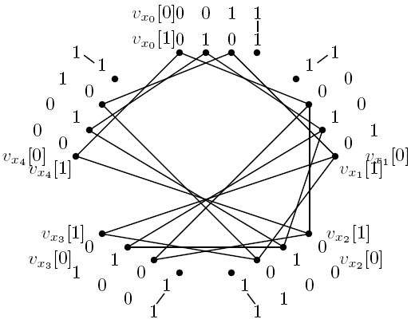
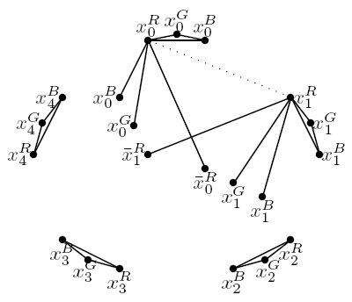
Other CSP to SAT Encodings

Slide 12
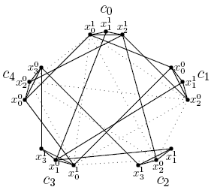
SAT to CSP Encodings (LITERAL)

Slide 13
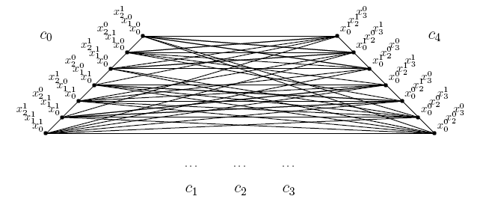
SAT to CSP Encodings (DUAL)

Slide 14
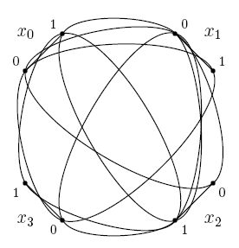
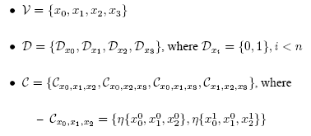
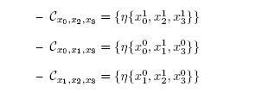
SAT to CSP Encodings (NON-LITERAL)

Slide 15
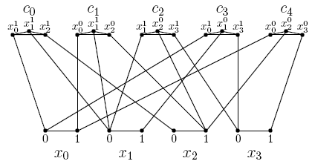
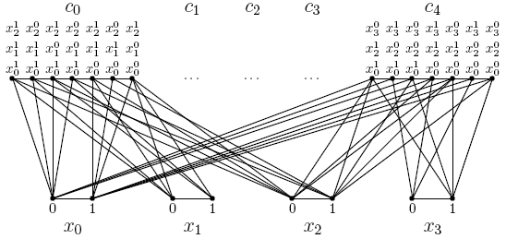
‘COMBINED’ SAT to CSP Encodings Extended Literal (Place) Hidden Variable

Slide 16

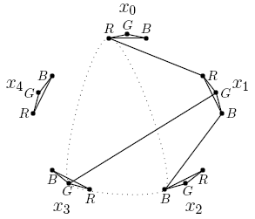
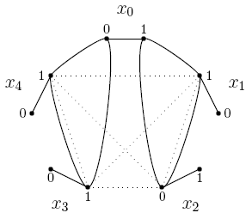
k-consistency  k-resolution

Slide 17
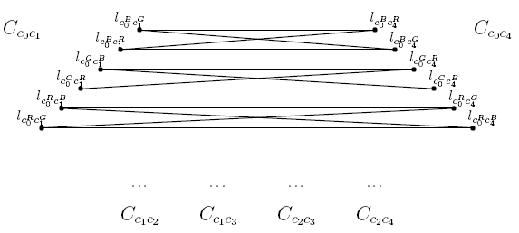

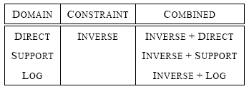
Inverse Encoding (CSP -> SAT)

Slide 18
Extended Proof Systems.... ....and the P vs. NP Problem
Extended-Resolution
The inclusion of additional variables
No known problems have been shown to be ‘hard’ for Extended Proof-Systems
But we don’t know how to add variables to make a problem tractable
Extended-Consistency

Slide 19
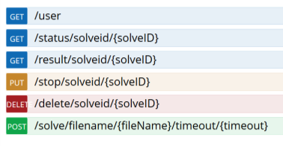
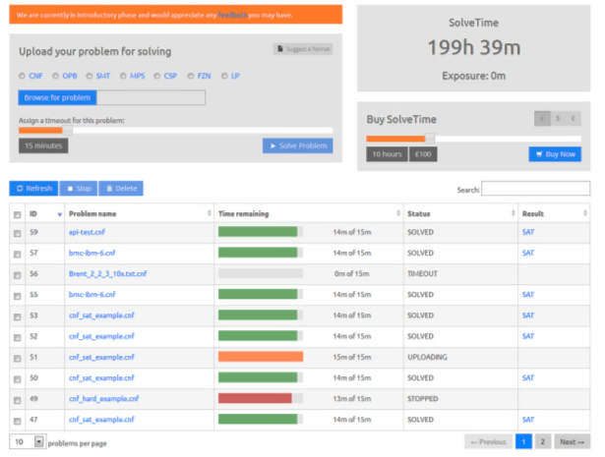
API, Web-portal & Services
Algorithm Scoping & Optimisation Insights
Modelling & Algorithm Design
Seamless Integration & Future-Proofing

Slide 20
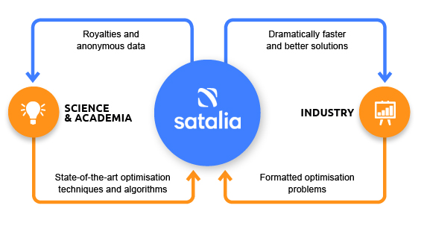
Award-Winning Business Model

Slide 21

Thank You
21
Dr. Daniel Hulme
07773765097 // @TheSolveEngine
daniel@satalia.com // d.hulme@ucl.ac.uk

Slide 22
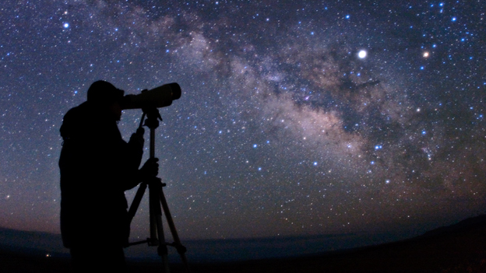
“Computer Science is no more about Computers than Astronomy is about Telescopes” Dijkstra(?)

Slide 23
Dijkstra’s Shortest Path Algorithm Finding the Shortest Path between A and B
A
B

Slide 24
The Travelling Salesmen Problem Finding the Shortest Path between Many Points
ROUTE | DISTANCE
a,b,c,d | 165
a,b,d,c | 150
a,c,b,d | 150
a,c,d,b | 169
a,d,b,c | 110
a,d,c,b | 119
b,a,c,d | 138
b,a,d,c | 105
b,c,a,d | 137
b,c,d,a | 121
b,d,a,c | 197
b,d,c,a | 200
c,a,b,d | 197
c,a,d,b | 120
c,b,a,d | 110
c,b,d,a | 103
c,d,a,b | 189
c,d,b,a | 155
d,a,b,c | 198
d,a,c,b | 146
d,b,a,c | 160
d,b,c,a | 132
d,c,a,b | 137
d,c,b,a | 129
d
a
x
c
b
4! = 4 x 3 x 2 x 1 = 24

Slide 25
The Travelling Salesmen Problem Finding the Shortest Path between Many Points
ROUTE | DIST |  | ROUTE | DIST |  | ROUTE | DIST |  | ROUTE | DIST
a,b,c,d,e | 200 |  | b,d,e,a,c | 112 |  | d,b,c,a,e | 138 |  | e,a,d,b,c | 185
a,b,c,e,d | 166 |  | b,d,e,c,a | 185 |  | d,b,c,e,a | 130 |  | e,a,d,c,b | 187
a,b,d,c,e | 136 |  | b,e,a,c,d | 130 |  | d,b,e,a,c | 119 |  | e,b,a,c,d | 171
a,b,d,e,c | 173 |  | b,e,a,d,c | 147 |  | d,b,e,c,a | 161 |  | e,b,a,d,c | 165
a,b,e,c,d | 145 |  | b,e,c,a,d | 110 |  | d,c,a,b,e | 174 |  | e,b,c,a,d | 164
a,b,e,d,c | 116 |  | b,e,c,d,a | 194 |  | d,c,a,e,b | 199 |  | e,b,c,d,a | 123
a,c,b,d,e | 114 |  | b,e,d,a,c | 167 |  | d,c,b,a,e | 122 |  | e,b,d,a,c | 175
a,c,b,e,d | 198 |  | b,e,d,c,a | 128 |  | d,c,b,e,a | 183 |  | e,b,d,c,a | 107
a,c,d,b,e | 189 |  | c,a,b,d,e | 196 |  | d,c,e,a,b | 183 |  | e,c,a,b,d | 145
a,c,d,e,b | 170 |  | c,a,b,e,d | 157 |  | d,c,e,b,a | 143 |  | e,c,a,d,b | 182
a,c,e,b,d | 131 |  | c,a,d,b,e | 181 |  | d,e,a,b,c | 199 |  | e,c,b,a,d | 196
a,c,e,d,b | 184 |  | c,a,d,e,b | 141 |  | d,e,a,c,b | 168 |  | e,c,b,d,a | 139
a,d,b,c,e | 148 |  | c,a,e,b,d | 181 |  | d,e,b,a,c | 183 |  | e,c,d,a,b | 119
a,d,b,e,c | 199 |  | c,a,e,d,b | 147 |  | d,e,b,c,a | 130 |  | e,c,d,b,a | 170
a,d,c,b,e | 191 |  | c,b,a,d,e | 142 |  | d,e,c,a,b | 120 |  | e,d,a,b,c | 112
a,d,c,e,b | 197 |  | c,b,a,e,d | 113 |  | d,e,c,b,a | 135 |  | e,d,a,c,b | 114
a,d,e,b,c | 142 |  | c,b,d,a,e | 171 |  | e,a,b,c,d | 180 |  | e,d,b,a,c | 161
a,d,e,c,b | 133 |  | c,b,d,e,a | 158 |  | e,a,b,d,c | 144 |  | e,d,b,c,a | 118
a,e,b,c,d | 162 |  | c,b,e,a,d | 153 |  | e,a,c,b,d | 158 |  | e,d,c,a,b | 144
a,e,b,d,c | 195 |  | c,b,e,d,a | 187 |  | e,a,c,d,b | 123 |  | e,d,c,b,a | 104
a,e,c,b,d | 124 |  | b,c,a,d,e | 179 |  | c,e,d,a,b | 113 |  | c,d,a,b,e | 174
a,e,c,d,b | 152 |  | b,c,a,e,d | 184 |  | c,e,d,b,a | 144 |  | c,d,a,e,b | 104
a,e,d,b,c | 175 |  | b,c,d,a,e | 119 |  | d,a,b,c,e | 189 |  | c,d,b,a,e | 191
a,e,d,c,b | 163 |  | b,c,d,e,a | 174 |  | d,a,b,e,c | 168 |  | c,d,b,e,a | 192
b,a,c,d,e | 146 |  | b,c,e,a,d | 117 |  | d,a,c,b,e | 161 |  | c,d,e,a,b | 101
b,a,c,e,d | 112 |  | b,c,e,d,a | 113 |  | d,a,c,e,b | 105 |  | c,d,e,b,a | 152
b,a,d,c,e | 169 |  | b,d,a,c,e | 192 |  | d,a,e,b,c | 148 |  | c,e,a,b,d | 125
b,a,d,e,c | 181 |  | b,d,a,e,c | 190 |  | d,a,e,c,b | 131 |  | c,e,a,d,b | 133
b,a,e,c,d | 100 |  | b,d,c,a,e | 138 |  | d,b,a,c,e | 178 |  | c,e,b,a,d | 122
b,a,e,d,c | 146 |  | b,d,c,e,a | 162 |  | d,b,a,e,c | 125 |  | c,e,b,d,a | 113
e
d
a
x
c
b
5! = 5 x 4 x 3 x 2 x 1 = 120

Slide 26
The Travelling Salesmen Problem Finding the Shortest Path between Many Points
POINTS | ROUTES | MEGA OPS / S
10 | 3,628,800 | 4 seconds
11 | 39,916,800 | 1 minute
13 | 6,227,020,800 | 2 hours
14 | 87,178,291,200 | 1 day
16 | 20,922,789,888,000 | 1 year
20 | 2,432,902,008,176,640,000 | 77,000 years
22 | 1,124,000,727,777,610,000,000 | 36 millennia
24 | 620,448,401,733,239,000,000,000 | 20 billion years
24! = 24 x 23 x 22 x 21 x …. x 4 x 3 x 2 x 1 = 620,448,401,733,239,000,000,000

